Slide 1
ADA BOOSTING REGRESSOR
An AdaBoost regressor (meta estimator) is an ensemble method that combines multiple weak regression models (often decision trees) to improve predictive performance. Initially, a regressor is trained on the dataset, and subsequent regressors are trained on the same dataset but with adjusted weights, giving more focus to instances where the previous regressor made errors. This iterative process helps the model to correct mistakes and perform better on difficult cases.

Slide 2
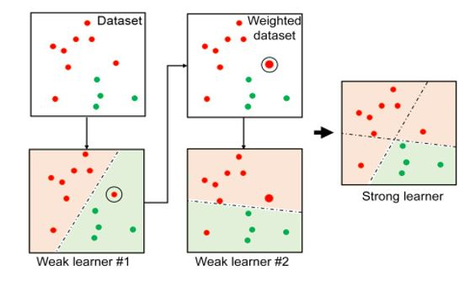
ADA Boost Example from sklearn.ensemble import AdaBoostRegressor regr = AdaBoostRegressor(random_state=0, n_estimators=100) regr.fit(X, y)

Slide 3
How ADABoost Works
Initialization:
Begin by assigning equal weights to all training examples.
Train Weak Learner:
Train a weak learner (e.g., decision stump) on the dataset.
Calculate Error:
Compute the weighted error rate of the classifier
Update Weights:
Increase the weights of the misclassified instances, so that the next weak learner will focus more on these harder examples.
Repeat:
Repeat steps 2-4 for a fixed number of iterations or until no further improvements can be made.
Final Model:
The final model is a weighted combination of all the weak learners, where more accurate learners are given higher weights.

Slide 4
Common Use Cases of AdaBoost Regressor
Improving Performance on Small to Medium Datasets
Handling Non-linear Data
Modeling Complex Data Distributions
Improving Weak Regressors
Regression Tasks in Business and Economics
Real-world Examples:
Financial Forecasting
Medical Predictions
Energy Demand Prediction

Slide 5
Advantages of Using AdaBoost Regressor
Increased Accuracy
Focus on Hard-to-Predict Instances
Reduced Overfitting
Works Well with Simple Models
No Feature Scaling Required
Disadvantages of Using AdaBoost Regressor
Sensitive to Noisy Data.
Computationally Intensive
Risk of Over fitting
Base Learner Limitations

Slide 6
XG Boosting Regressor
XGBoost (Extreme Gradient Boosting) is an optimized, efficient, and scalable version of the gradient boosting algorithm. It is widely used for machine learning tasks, particularly for regression and classification problems, due to its high performance and speed. XG Boost is a type of boosting algorithm that combines the predictions of multiple weak learners (typically decision trees) to form a strong prediction.
XGBoost is highly effective for both structured (tabular) data and datasets with many features, and it can be used for both regression and classification tasks.

Slide 7
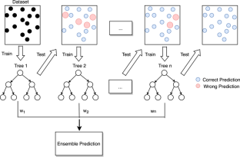
XG BOOSTER EXAMPLE
from sklearn.ensemble import GradientBoostingRegressor
regressor=GradientBoostingRegressor(loss='absolute_error',
learning_rate=0.1,n_estimators=300, max_depth = 1,max_features = 5)

Slide 8
How XG BOOST WORKS
XGBoost builds trees sequentially, where each tree tries to correct the errors made by the previous tree. The steps involved are:
Initialization
Tree Construction
Gradient Descent
Regularization
Boosting

Slide 9
Common uses of the XGBoost Regressor
XGBoost is a powerful algorithm that is widely used in various domains for regression tasks. Its versatility, high accuracy, speed, and ability to handle large and complex datasets make it ideal for:
Predicting continuous target variables
Time series forecasting
Risk and financial analysis
Customer behavior prediction
Supply chain and resource management
Marketing optimization
By applying XGBoost in these areas, organizations can make more informed decisions, improve predictions, and achieve better overall performance.

Slide 10
Advantages of XGBoost Regressor
High Accuracy
Efficiency and Speed
Regularization
Handling Missing Data
Flexibility
Robustness to Overfitting
Support for Parallel and Distributed Computing
Feature Importance
Disadvantages of XGBoost Regressor
Complexity
Sensitivity to Noisy Data
Long Training Time for Large Datasets
Black Box
5.Memory Usage
Overfitting with Many Trees

Slide 11
LightGBM (Light Gradient Boosting Machine)
LightGBM (Light Gradient Boosting Machine) is a highly efficient, scalable, and fast implementation of the gradient boosting algorithm. It was developed by Microsoft and is optimized for performance, particularly on large datasets. LightGBM is similar to other boosting methods, such as XGBoost, but has several improvements that make it more efficient and effective, especially when dealing with large datasets.
LightGBM is used for both classification and regression tasks and can handle large-scale data with high-dimensional features. It’s also known for its speed, low memory usage, and high accuracy.

Slide 12
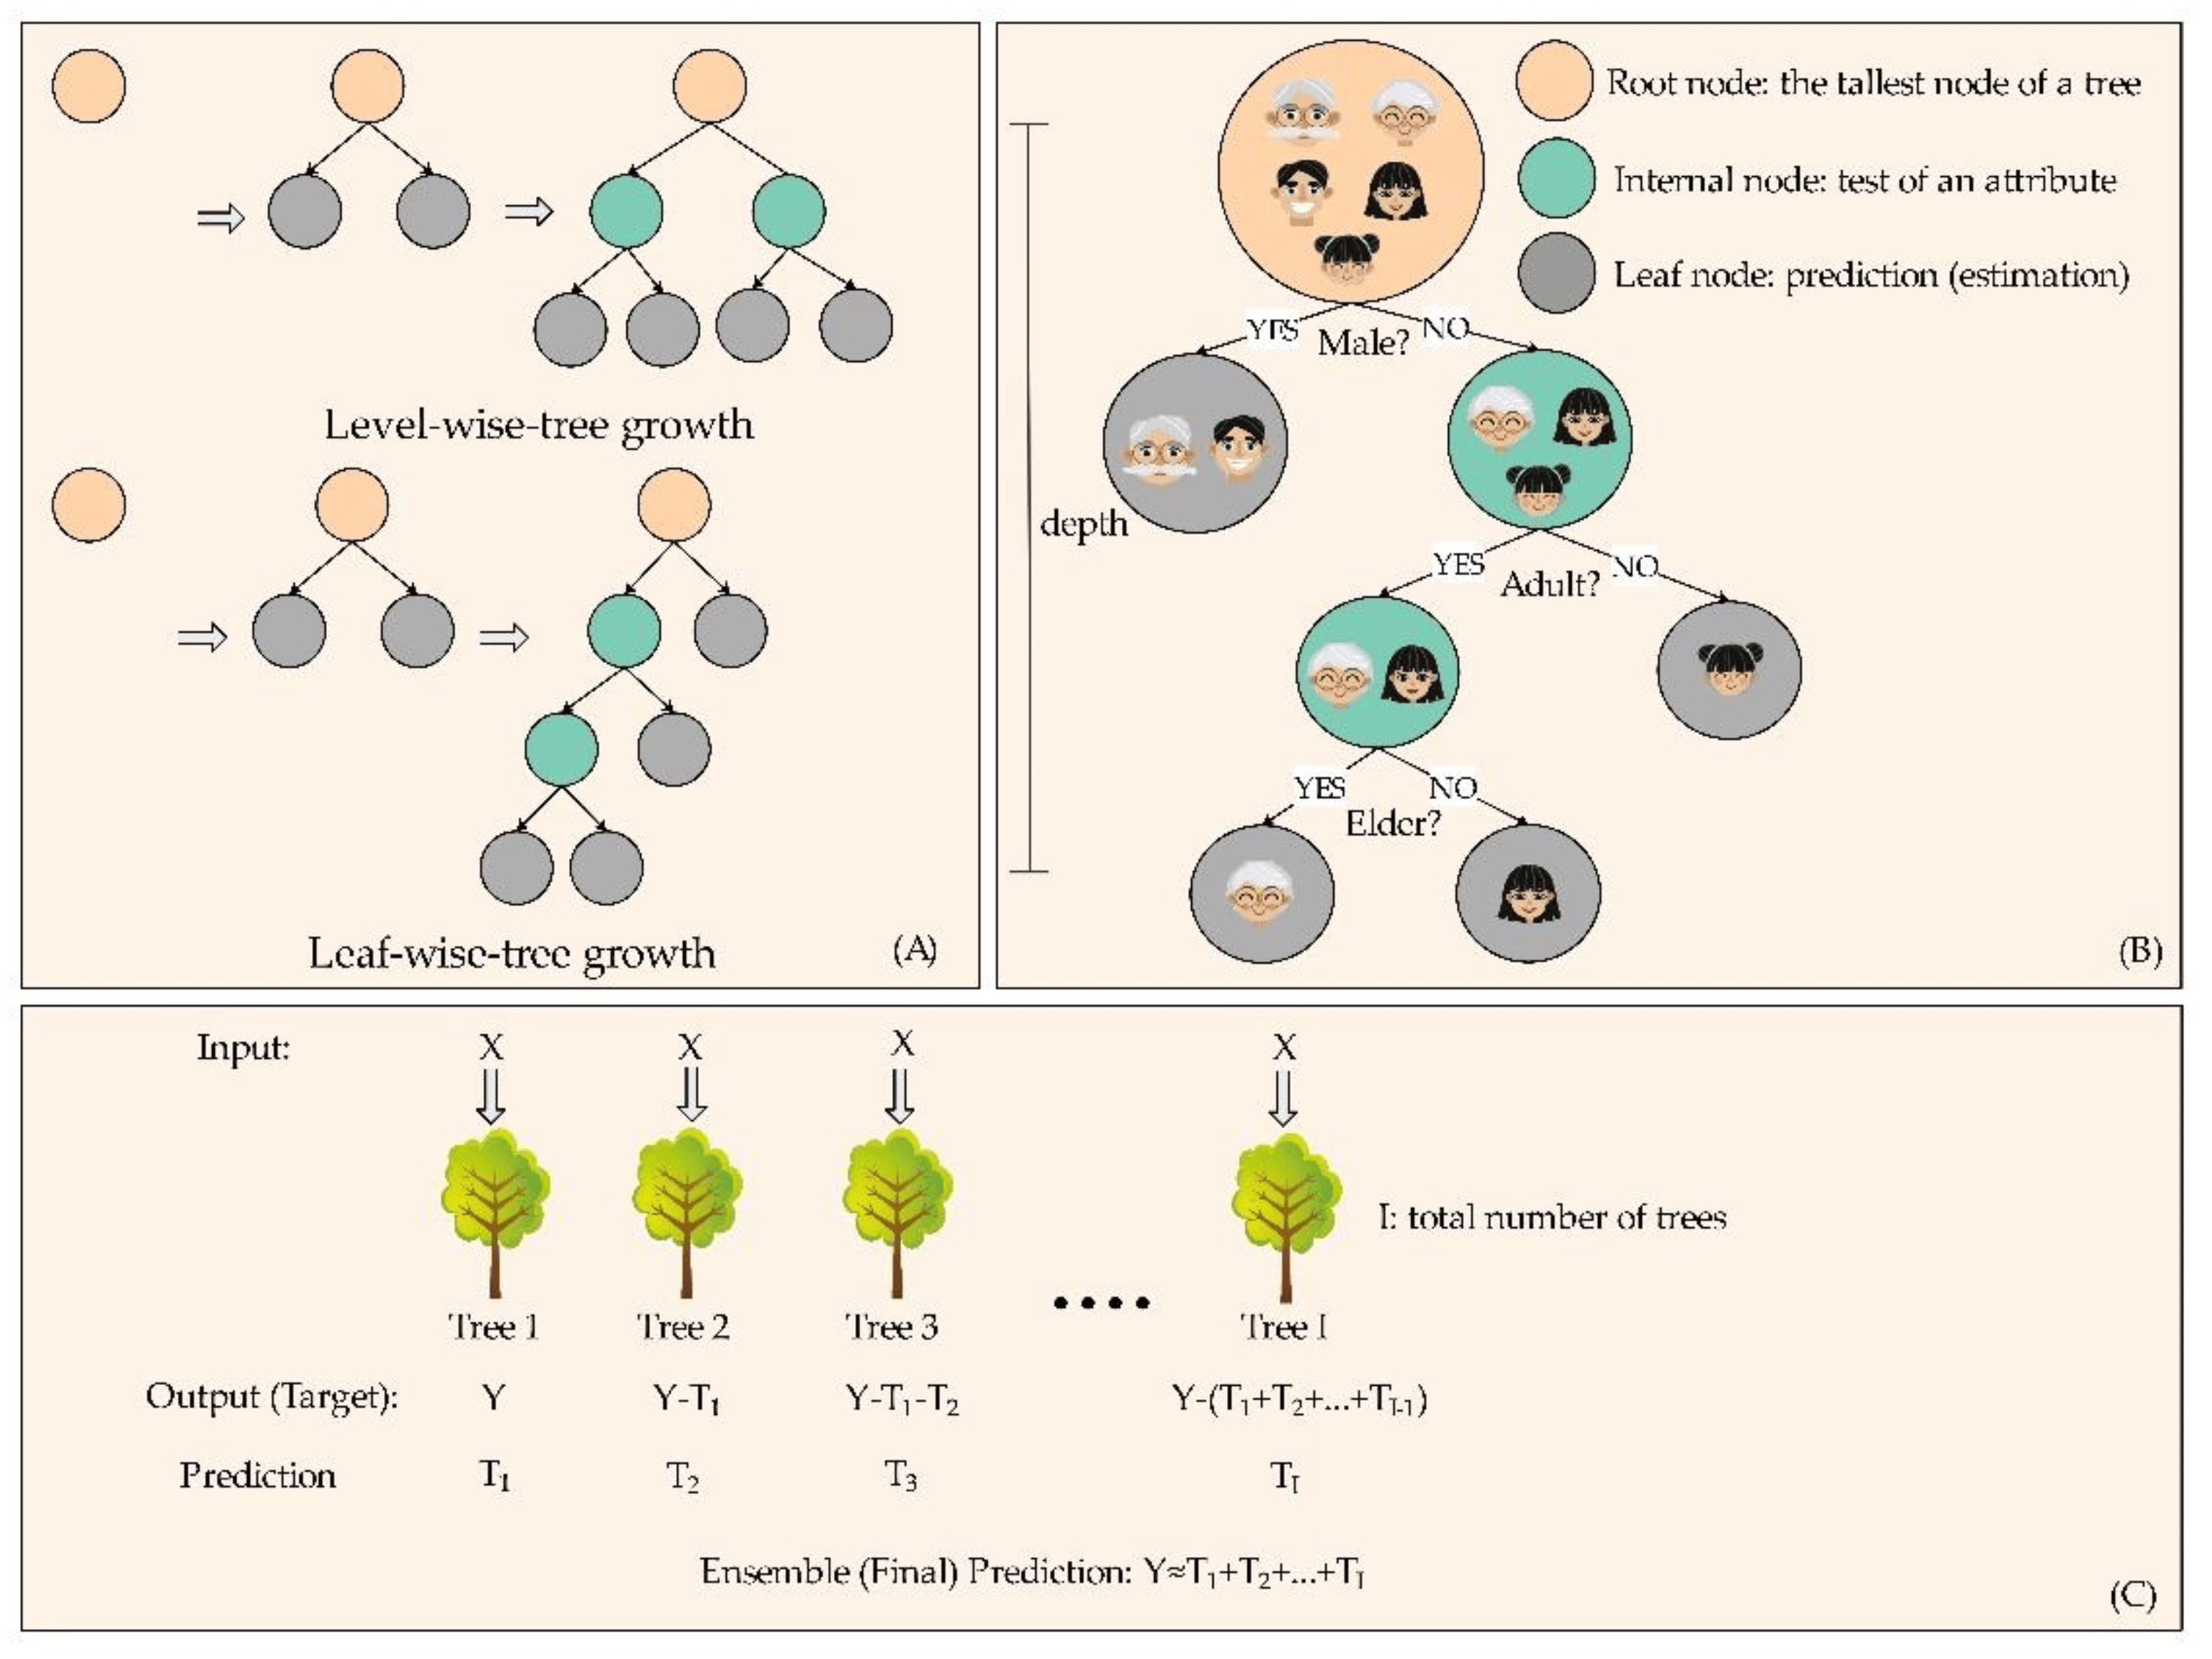
Example of LGBMRegressor
from lightgbm import LGBMRegressor
regressor=LGBMRegressor( boosting_type='gbdt', max_depth=-1,
learning_rate=0.05, n_estimators=100, num_leaves=31 )

Slide 13
How LightGBM Works
Initialization
Train Decision Trees
Objective Function
Boosting Process
Common uses of LightGBM Regressor
Predicting Continuous Target Variables (Regression Tasks)
Time Series Forecasting
3. Customer Lifetime Value (CLV) Prediction
4. Credit Risk and Loan Default Prediction
5. Healthcare Predictions
6. Energy Efficiency and Renewable Energy Prediction
Supply Chain Optimization
8. Marketing Analytics and A/B Testing
Anomaly Detection
10. Manufacturing and Predictive Maintenance

Slide 14
Advantages of LightGBM Regressor
High Speed and Efficiency
Scalability
High Accuracy:
Efficient Handling of Categorical Features
Regularization
Parallel and GPU Support
Less Memory Usage
Disadvantages of LightGBM Regressor
1.Overfitting in Small Datasets
Hyperparameter Tuning
Interpretability
Sensitive to Noisy Data
Memory Consumption for Large Trees
Non-Deterministic Results

